Slide 1
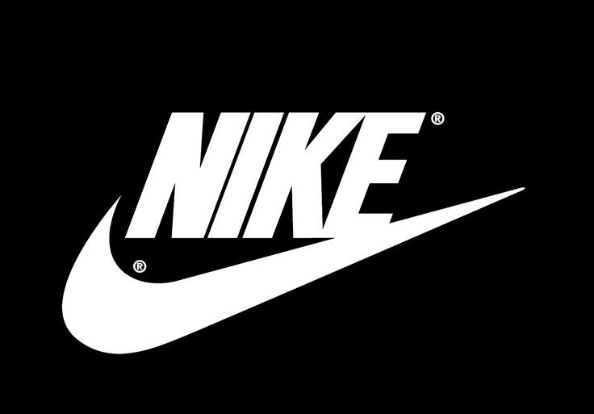
Financial Analysis of NIKE Inc.
Amit Lamsal
CSDA 5310: Data Visualizations
Student Id: 4262165
12/17/2024

Slide 2

Background
Financial Analysis is the process of assessing the financial health of a company using its key metrics.
Nike is the global market leader in sportswear and apparel and are also renowned for its innovation, branding, sustainability.
Data Exploration: (Dataset Obtained from official company (nike.com) and Government (sec.gov) websites.
Statements | Metrics Used
Income Statement | Revenue, Cost of Sales, Gross Profit, Net Profit
Balance Sheet | Total Assets, Total Liabilities, Shareholders Equity
Industry Statement | Gross Industry Average,

Slide 3
Analysis Goals
The major objective is to determine why one should consider NIKE for their investment and is it really the global leader that we heard of ?
How has been the NIKE’s Revenue and Expenses trend ?
How has Profit margin trend changed over time?
How favourable is NIKE’s Liquidity position?
Comparison of Assets, Liabilities and Equity over time.
Comparison of Actual Revenue with Industry Average.

Slide 4
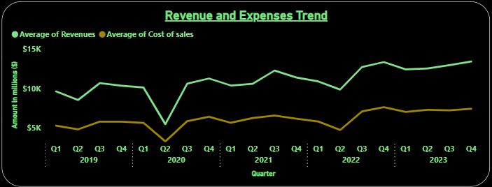
Analysis: Revenue and Expenses Trend
Revenue Growth has outpaced the expenses in the given time frame.
There seems to be huge dip in revenue in the year 2020. which suggests the post pandemic effect in business.
Cyclical trend

Slide 5

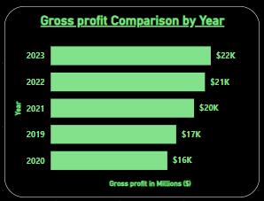
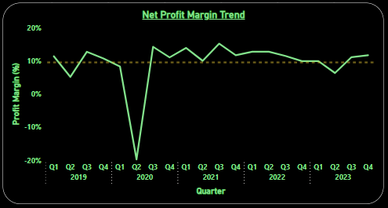
Profit Margin Trend
Gross Profit bounced back after the post pandemic demonstrating NIKE’s strong pricing and cost control.
Sudden Dip in 2020 due to COVID.
The net profit margin trend exceeds the industry expected net profit margin growth rate (around 7% to 9%).
Recovery and stabilization Phase after the pandemic.

Slide 6
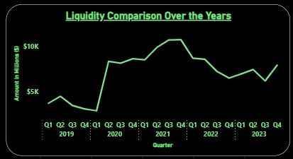
Liquidity Position
Cash and Equivalents were used for monitoring the Liquidity position over time.
Fluctuations are highly seen.
Notable Spike in the year 2020 and 2021 due to the adoption of precautionary measures in the pandemic period.
Stable Liquidity post pandemic but slightly declining.

Slide 7
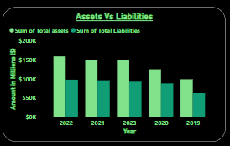
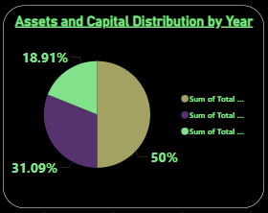
Comparison: Assets, Liabilities, and Shareholders Equity
Total Assets is equal to the sum of Total Liabilities and Total Shareholders Equity In 2023, Total Assets = 50%, Total Liabilities = 31.09%, and
Total Shareholders Equity = 18.91%.
Total assets consistently exceeds total liabilities which demonstrates strong financial position and low solvency risk.
Depiction of good mix of assets and balanced capital structure resulting in enhanced financial stability.

Slide 8
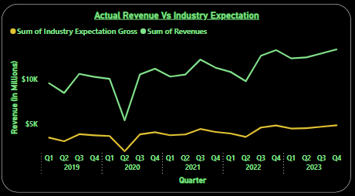
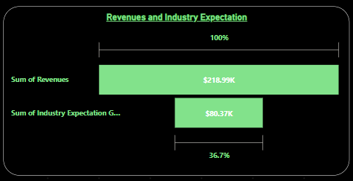
Revenue Vs Industry Average
Nike consistently outperformed the industry benchmark, which demonstrates its strong hold in the market as compared to its competitors.
Nike collected more than 36.7% revenue than that of its competitors.
This represents its superior performance and enhanced market leadership in its field.

Slide 9
Conclusion
Increase in gap between Revenue and Expenses.
Balanced and Consistent enhancement in profit measures.
Secured Liquidity position implying company’s ability to face unforeseen circumstances (example: COVID).
Good Mix of Current assets and Long-term assets which results in better operations and financial stability.
Balanced Capital Structure which will help them to enhance their growth aspects and build strong hold on sound financial health.
Outperformed industry benchmark and maintained continuous improvement in most of metrics through effective cost management and strategic adaptability.

Slide 10
Decision:
Will you make investment in NIKE ???

Slide 11
Recommendations
Decrease dependency on the premium products to gain revenue.
Increase Focus on other products with the consistent improvement in footwear.
Apply broader business concept by enhancing Supply chain efficiency.
Localized level of brand advertisement.
Continuous improvement Product Innovation and Digital transformation.

Slide 12
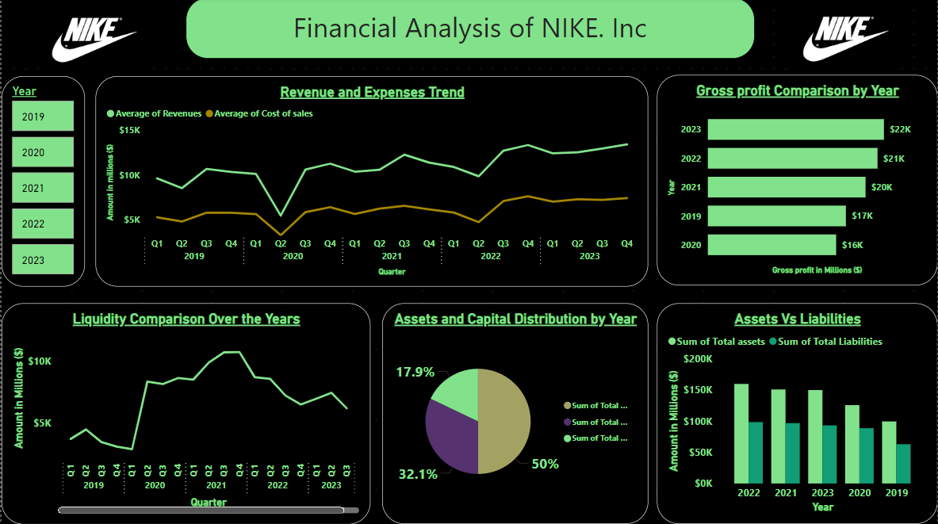

Slide 13
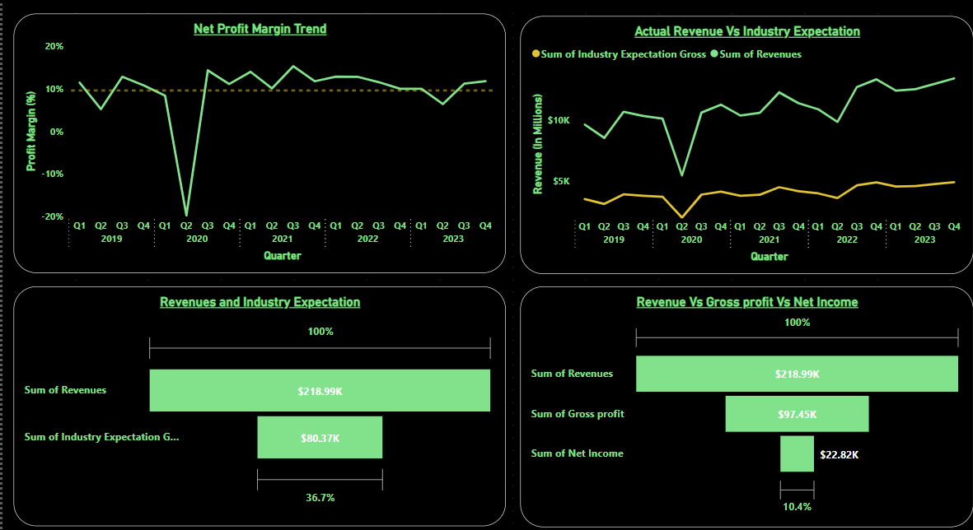

Slide 14

Questions ?

